Slide 1
Mining Social-Network Graphs Analysis of Large Graphs: Community Detection
Professor Wei-Min Shen
University of Southern California
Thanks for source slides and material to:
J. Leskovec, A. Rajaraman, J. Ullman: Mining of Massive Datasets
http://www.mmds.org
Note to other teachers and users of these slides: We would be delighted if you found this our material useful in giving your own lectures. Feel free to use these slides verbatim, or to modify them to fit your own needs. If you make use of a significant portion of these slides in your own lecture, please include this message, or a link to our web site: http://www.mmds.org

Slide 2
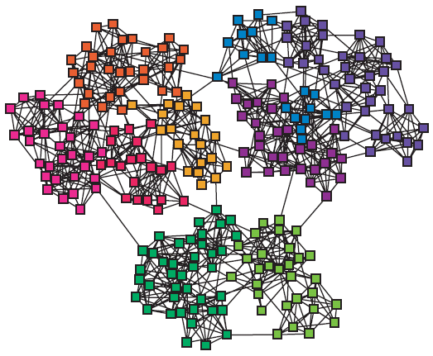
Networks & Communities
We often think of networks being organized into modules, cluster, communities:

Slide 3
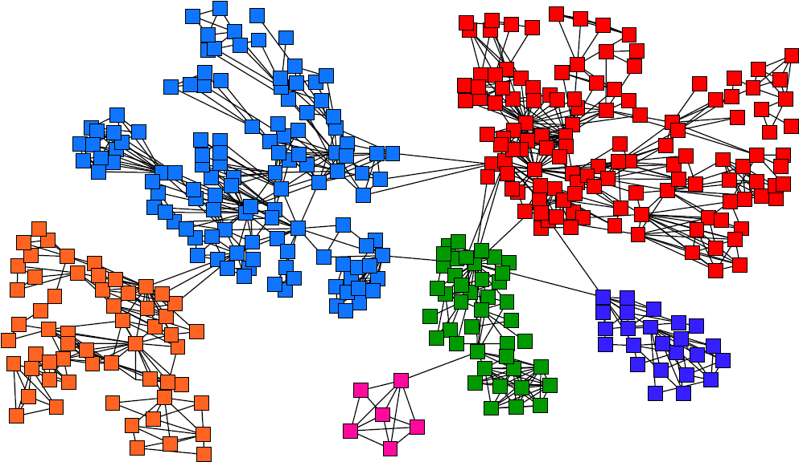
Goal: Find Densely Linked Clusters

Slide 4
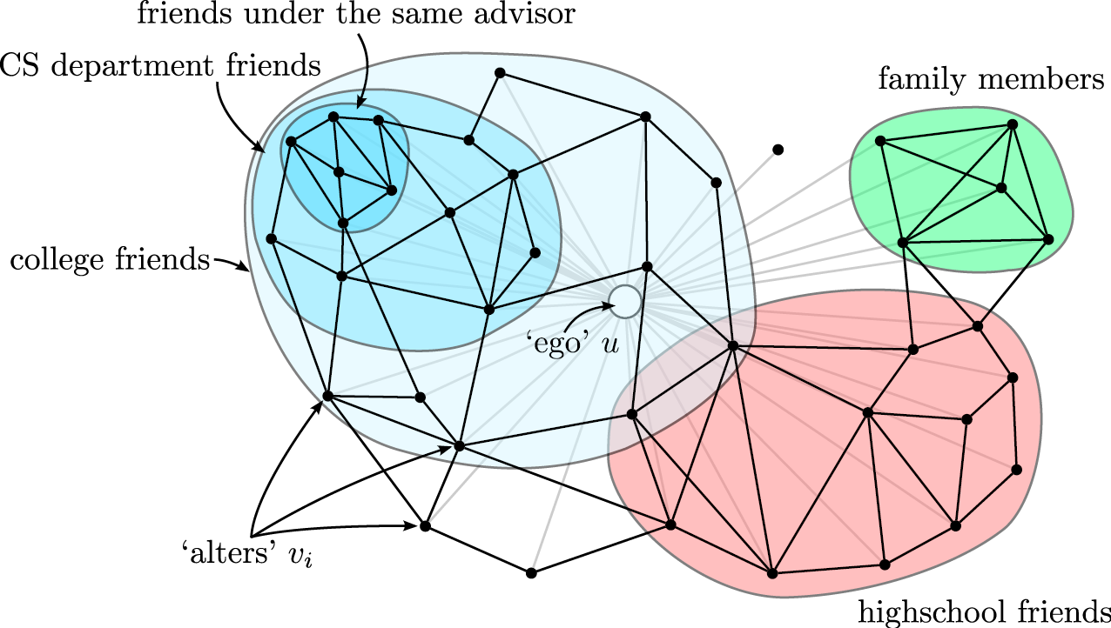
Twitter & Facebook
Discovering social circles, circles of trust:
[McAuley, Leskovec: Discovering social circles in ego networks, 2012]

Slide 5
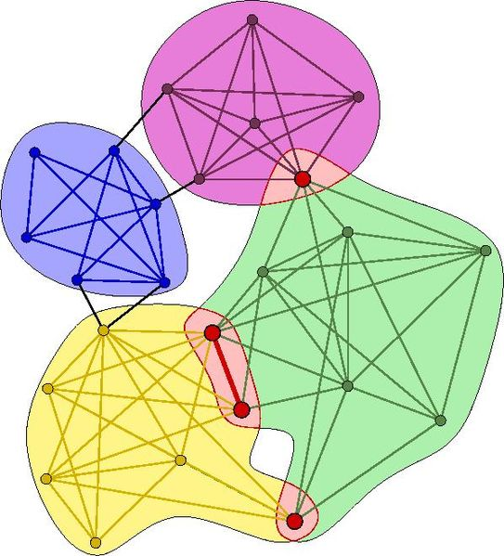
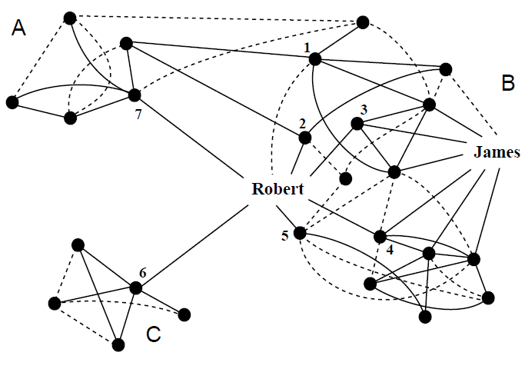
COMMUNITY DETECTION (GRAPH BASICS)
How to find communities?

Slide 6
COMMUNITY DETECTION (ALGORITHMS AND METHODS)
How to find communities?
We will work with undirected (unweighted) networks

Slide 7
Approaches
Clustering by edge ”betweenness”
Cut edges that have highest “betweenness”
Spectral Clustering
Minimizing the cut size by the 2nd Eigenvector
Direct Discovery
Thawing
Frequent itemsets

Slide 8
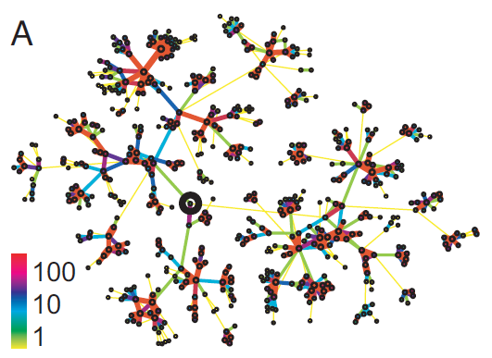
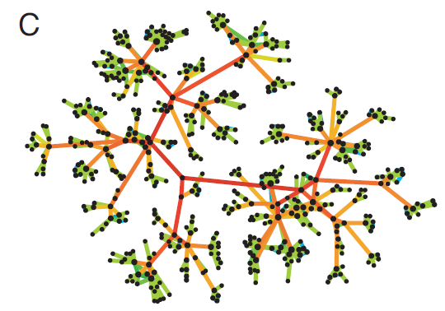
Betweenness Concept
Edge betweenness: Number of shortest paths passing over the edge
Intuition:
b=16
b=7.5
Edge strengths (call volume) in a real network
Edge betweenness in a real network

Slide 9
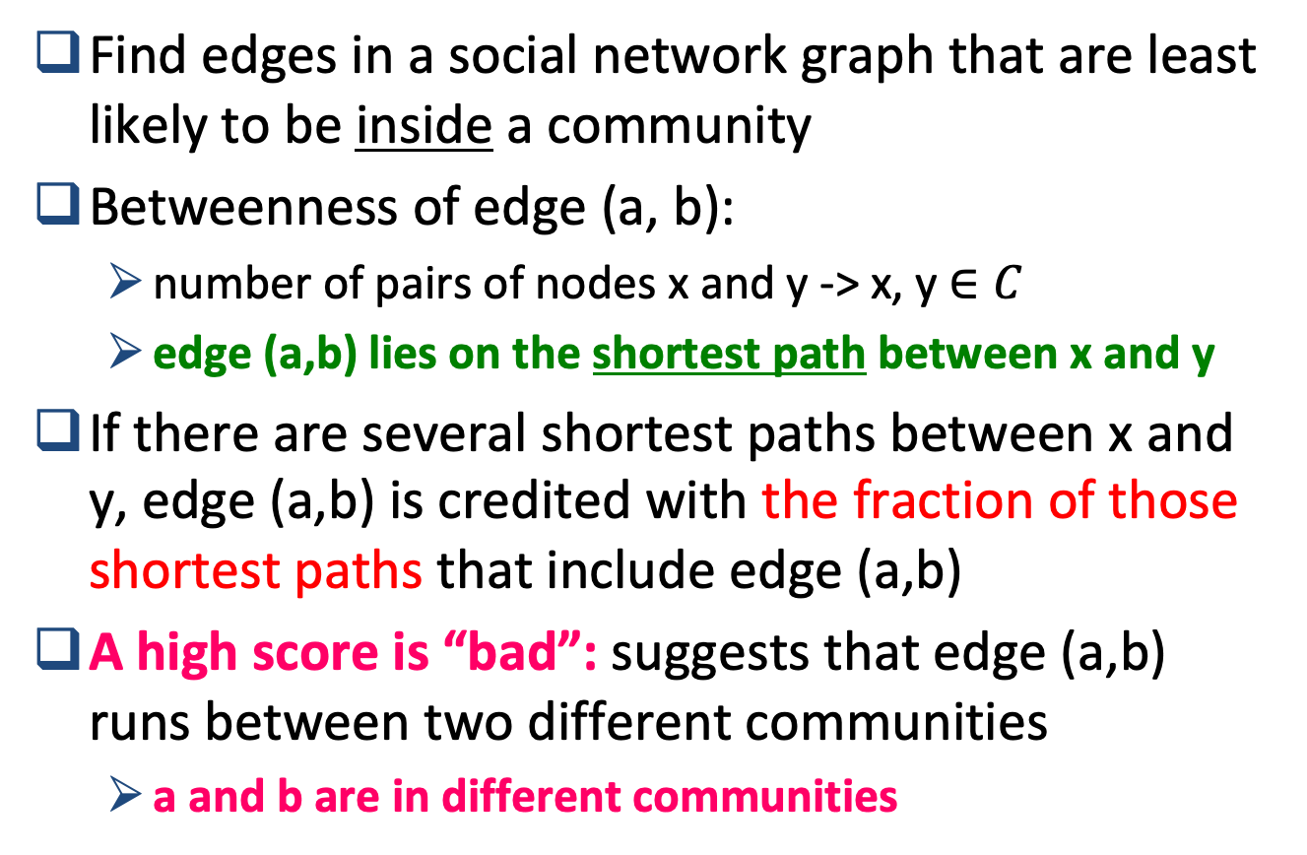
Betweenness Concept (Cont’d)

Slide 10
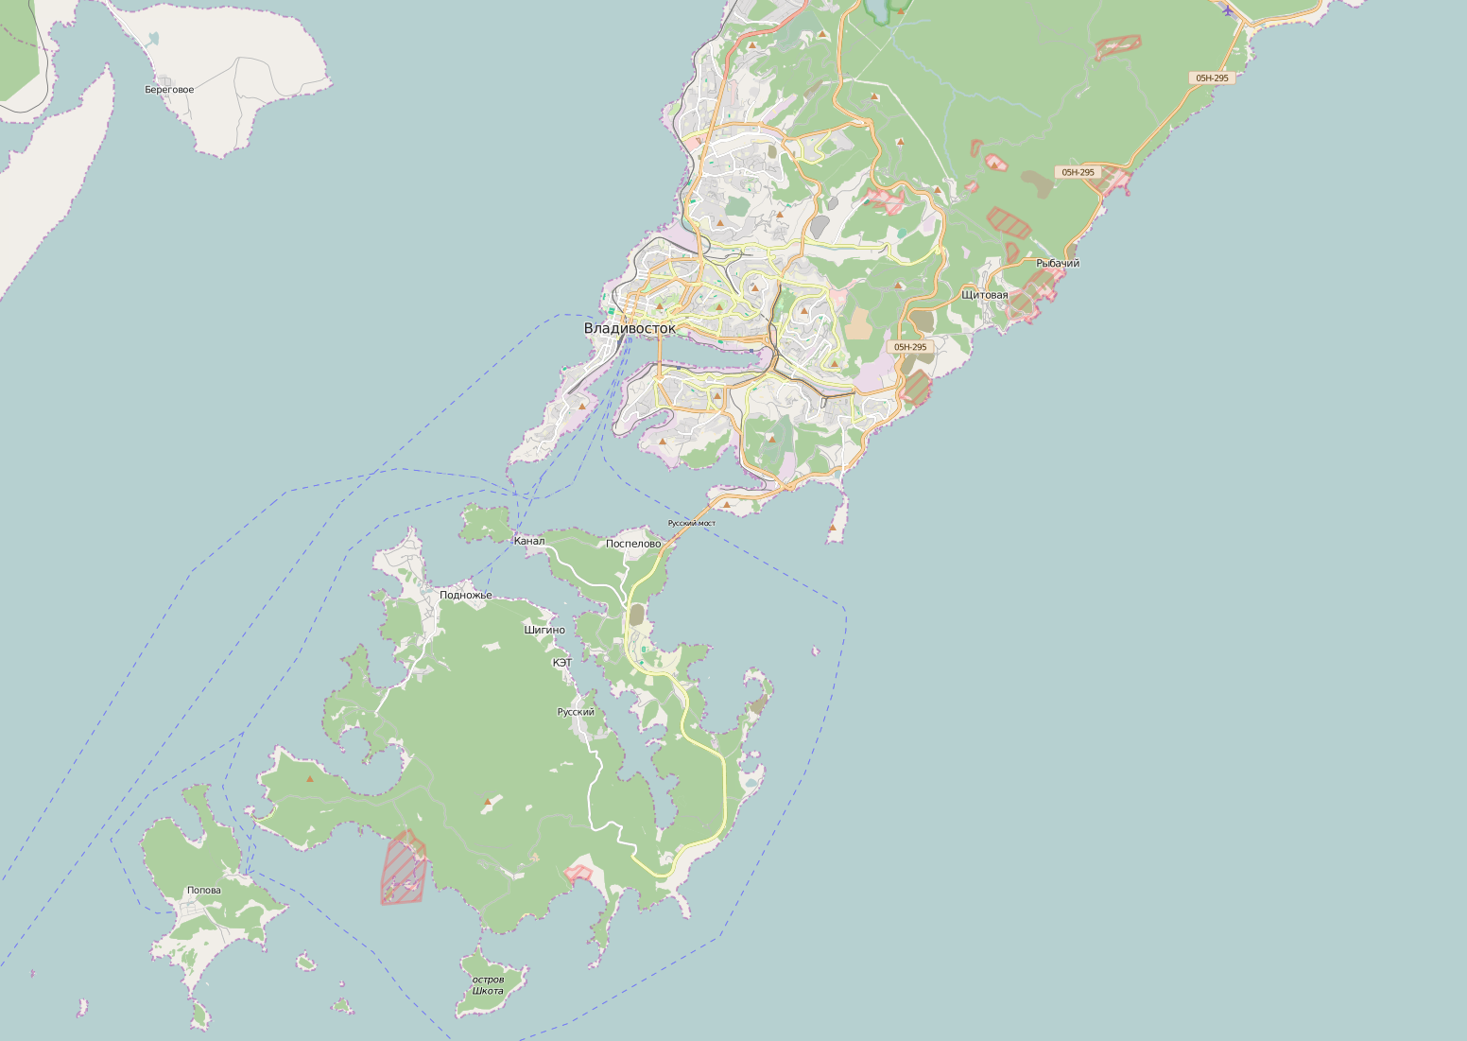
The Russian Bridge
Notes:
2018 w1.1

Slide 11
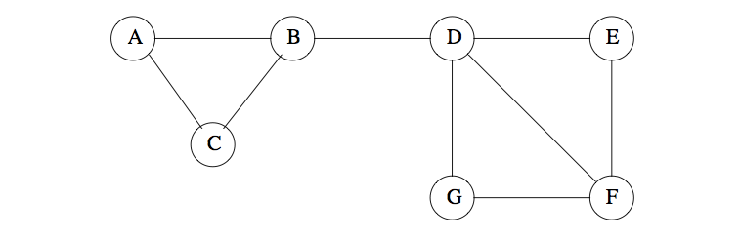
Betweenness Example
Expect that edge (B,D) has highest betweenness
(B,D) is on every shortest path from {A,B,C} to {D,E,F,G}
Betweenness of (B,D) = 3x4 = 12
(D,F) is on every shortest path from {A,B,C,D} to {F}
Betweenness of (D,F) = 4x1 = 4
Natural communities: {A,B,C} and {D,E,F,G}

Slide 12
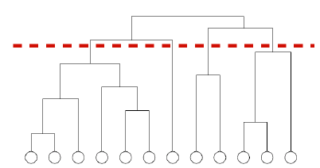
WE NEED TO RESOLVE 2 QUESTIONS
How to compute betweenness?
How to select the number of clusters?
Notes:
2016Springw1-1

Slide 13
The Girvan-Newman Algorithm
[Girvan-Newman ‘02]
Want to discover communities using divisive hierarchical clustering
Start with one cluster (the social network) and recursively split it
Will do this based on the notion of edge betweenness:
Number of shortest paths passing through the edge
Girvan-Newman Algorithm:
Visits each node X once
Computes the number of shortest paths from X to each of the other nodes that go through each of the edges
Repeat:
Calculate betweenness of edges
Thresholding to remove high betweeness edges, or
Remove edges with highest betweenness: between communities
Connected components are communities
Gives a hierarchical decomposition of the network

Slide 14
Girvan-Newman Algorithm (1)
Visit each node X once and compute the number of shortest paths from X to each of the other nodes that go through each of the edges
1) Perform a breadth-first search (BFS) of the graph, starting at node X
The depth level of each node in BFS is length of the shortest path from X to that node
So edges that go between nodes on the same depth level can never be part of a shortest path from X
Edges between depth levels are called DAG edges (DAG = Directed Acyclic Graph)
Each DAG edge is part of at least one shortest path from root X

Slide 15
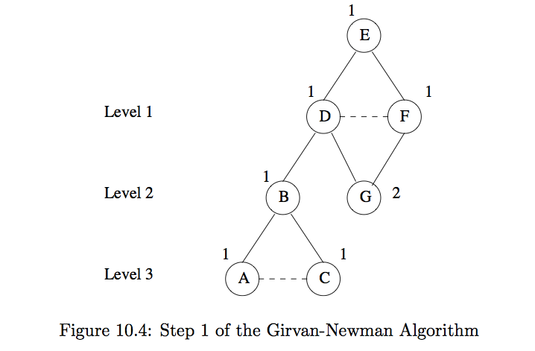
Girvan-Newman Algorithm (2)
2) Label each node by the number of shortest paths that reach it from the root node
Example: BFS starting from node E, labels assigned

Slide 16
Girvan-Newman Algorithm (3)
3) Calculate for each edge e, the sum over all nodes Y (of the fraction) of the shortest paths from the root X to Y that go through edge e
Compute this sum for nodes and edges, starting from the bottom of the graph
Each node other than the root node is given a credit of 1
Each leaf node in the DAG gets a credit of 1
Each node that is not a leaf gets credit = 1 + sum of credits of the DAG edges from that node to level below
A DAG edge e entering node Z (from the level above) is given a share of the credit of Z proportional to the fraction of shortest paths from the root to Z that go through e

Slide 17
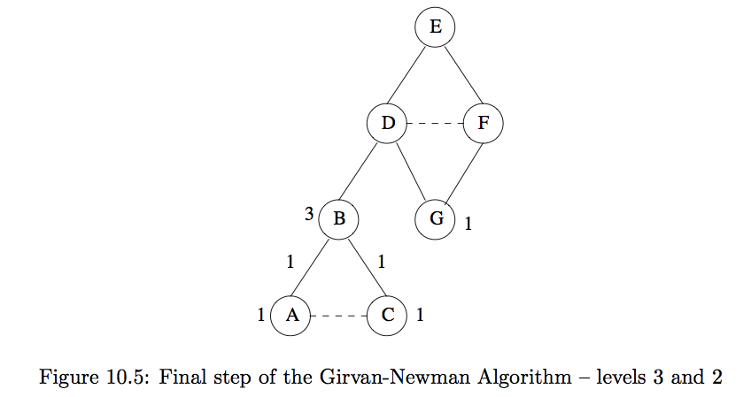
Girvan-Newman Algorithm (4)
Assign node and edge values starting from bottom

Slide 18
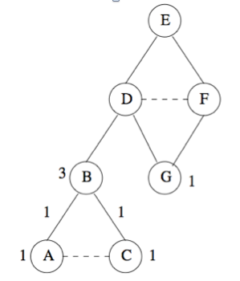
Girvan-Newman Algorithm (5)
3
?
?
Assigning credits:
A and C are leaves: get credit = 1
Each of these nodes has only one parent, so their credit=1 is given to edges (B,A) and (B,C)
At level 2, G is a leaf: gets credit = 1
B gets credit 1 + credit of DAG edges entering from below = 1 + 1 +1 = 3
B has only one parent, so edge (D,B) gets entire credit of node B = 3
Node G has 2 parents (D and F): how do we divide credit of G between the edges?

Slide 19
Girvan-Newman Algorithm (6)
4.5
1.5
4.5
1.5
3
0.5
0.5
In this case, both D and F have just one shortest path from E to each of those nodes
So, give half credit of node G to each of those edges
Credit = 1/(1 + 1) = 0.5
In general, how we distribute credit of a node to its edges depends on number of shortest paths
Say there were 5 shortest paths to D and only 3 to F
Then credit of edge (D,G) = 5/8 and credit of edge (F,G) = 3/8
Node D gets credit = 1 + credits of edges below it = 1 + 3 + 0.5 = 4.5
Node F gets credit = 1 + 0.5 = 1.5
D has only one parent, so Edge (E,D) gets credit = 4.5 from D
Likewise for F: Edge (E,F) gets credit = 1.5 from F

Slide 20
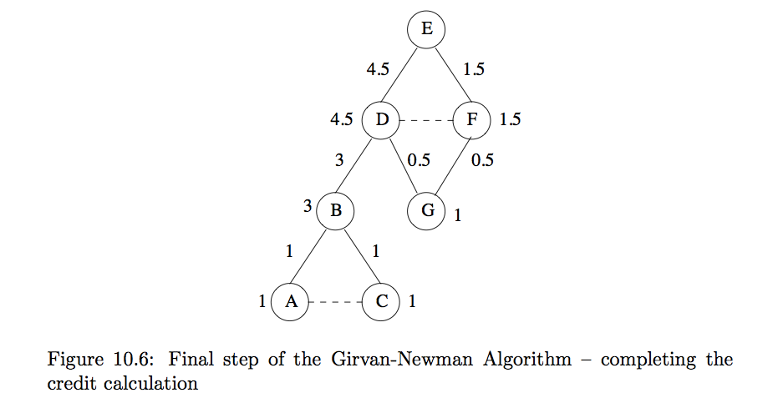
Girvan-Newman Algorithm (7): Completion of Credit Calculation rooted from node E
What is the value for E?

Slide 21
Girvan-Newman Algorithm (8): Overall Betweenness Calculation
To complete betweenness calculation, must:
Repeat this for every node as root
Sum the contributions on each edge
Divide by 2 to get true betweenness
Since every shortest path will be counted twice (up and down), once for each of its endpoints

Slide 22
Using Betweenness to Find Communities: Clustering
Betweenness scores for edges of a graph behave something like a distance metric
Not a true distance metric
Could cluster by taking edges in increasing order of betweenness and adding to graph one at a time
At each step, connected components of graph form clusters
Girvan-Newman: Start with the graph and all its edges and remove edges with highest betweenness
Continue until graph has broken into suitable number of connected components
Divisive hierarchical clustering (top down)
Start with one cluster (the social network) and recursively split it

Slide 23
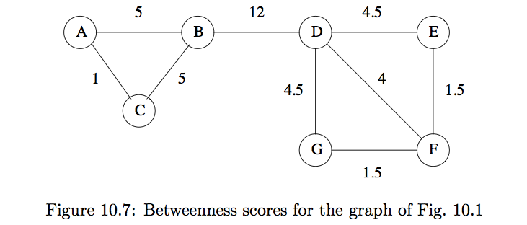
Using Betweenness to Find Communities (2)
(B,D) has highest betweenness (12)
Removing edge would give natural communities we identified earlier: {A,B,C} and {D,E,F,G}

Slide 24
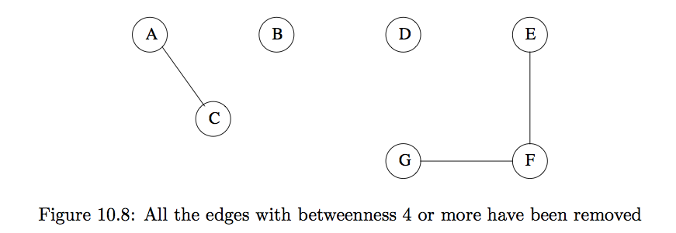
Using Betweenness to Find Communities (3): Thresholding
Could continue to remove edges with highest betweenness

Slide 25
Run Girvan-Newman Iteratively for Community Detection
[Girvan-Newman ‘02]
Recall: Divisive hierarchical clustering based on the notion of edge betweenness:
Number of shortest paths passing through the edge
Girvan-Newman Algorithm:
Undirected unweighted networks
Repeat until no edges are left:
Calculate betweenness of edges
This time: remove edges with highest betweenness
Connected components are communities
Gives a hierarchical decomposition of the network

Slide 26
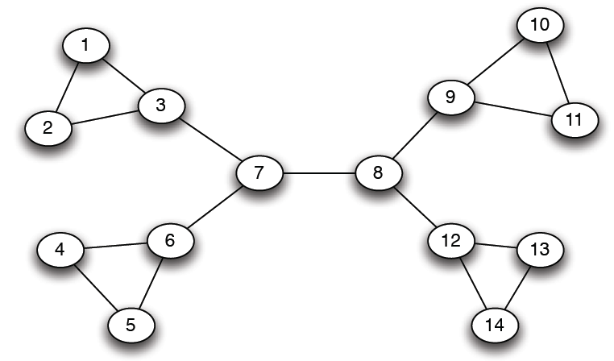
Girvan-Newman: Example
12
1
33
49
Need to re-compute betweenness at every step

Slide 27
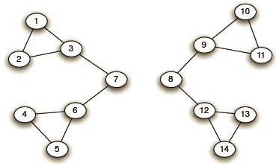
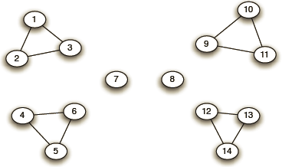
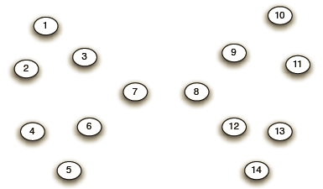
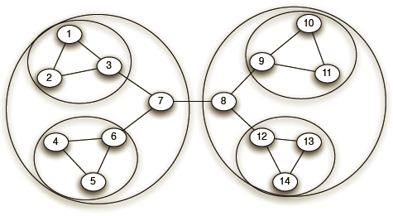
Girvan-Newman: Example
Step 1:
Step 2:
Hierarchical network decomposition:
Step 3:

Slide 28
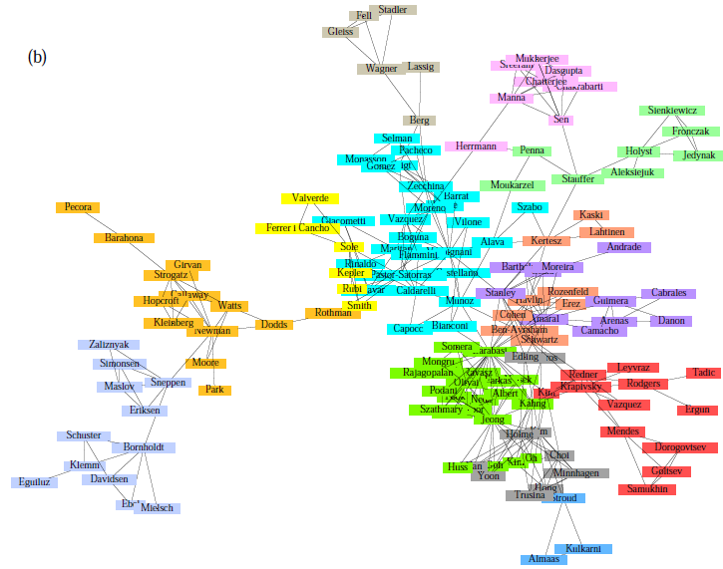
Girvan-Newman: Results
Communities in physics collaborations

Slide 29
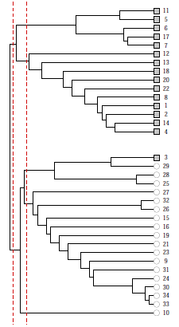
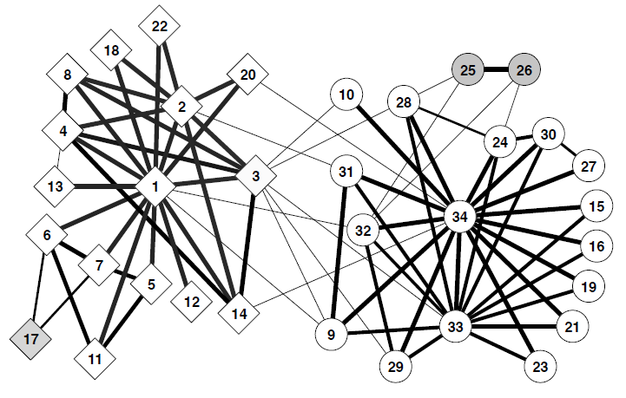
Girvan-Newman: Results
Zachary’s Karate club: Hierarchical decomposition

Slide 30
WE NEED TO RESOLVE 2 QUESTIONS
How to compute betweenness?
How to select the number of clusters?

Slide 31
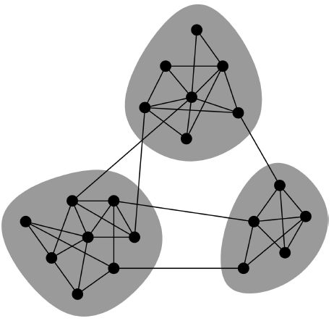
Network Communities
Communities: sets of tightly connected nodes
Define modularity Q
A measure of how well a network is partitioned into communities
Given a partition of the network into groups s in S
Q = Sum_{s_in_S} [(# edges in group s) – (expected # edges in group s)]
When s is empty? When s is full?
Need a null model!
The null model is a graph which matches one specific graph in some of its structural features, but which is otherwise taken to be an instance of a random graph. The null model is used as a term of comparison, to verify whether the graph in question displays some feature, such as community structure, or not.
Notes:
the null model is a graph which matches one specific graph in some of its structural features, but which is otherwise taken to be an instance of a random graph. The null model is used as a term of comparison, to verify whether the graph in question displays some feature, such as community structure, or not.

Slide 32
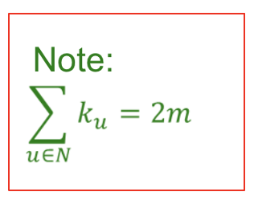
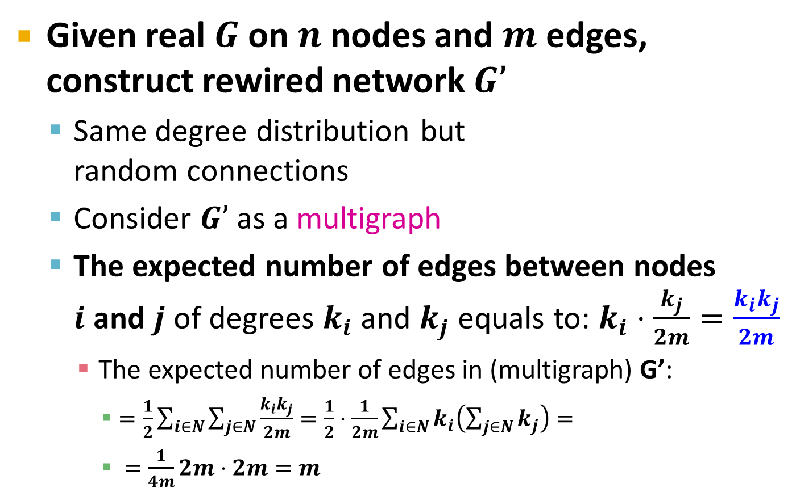
Null Model: Configuration Model
i
j
Notes:
where $k_i$ and $k_j$ are the degrees of $i$ and $j$, while $m$ is the number of edges of the graph. Notice that $k_i k_j / 2m$ is the expected number of edges between vertices $i$ and $j$ in the configuration model assumption. Indeed, consider a particular edge attached to vertex $i$. The probability that this edge goes to node $j$ is $k_j / 2m$, since the number of edges attached to $j$ is $k_j$ and the total number of edge ends in the network is $2m$ (the sum of all node degrees). Since node $i$ has $k_i$ edges attached to it, the expected number of edges between $i$ and $j$ is $k_i k_j / 2m$.

Slide 33
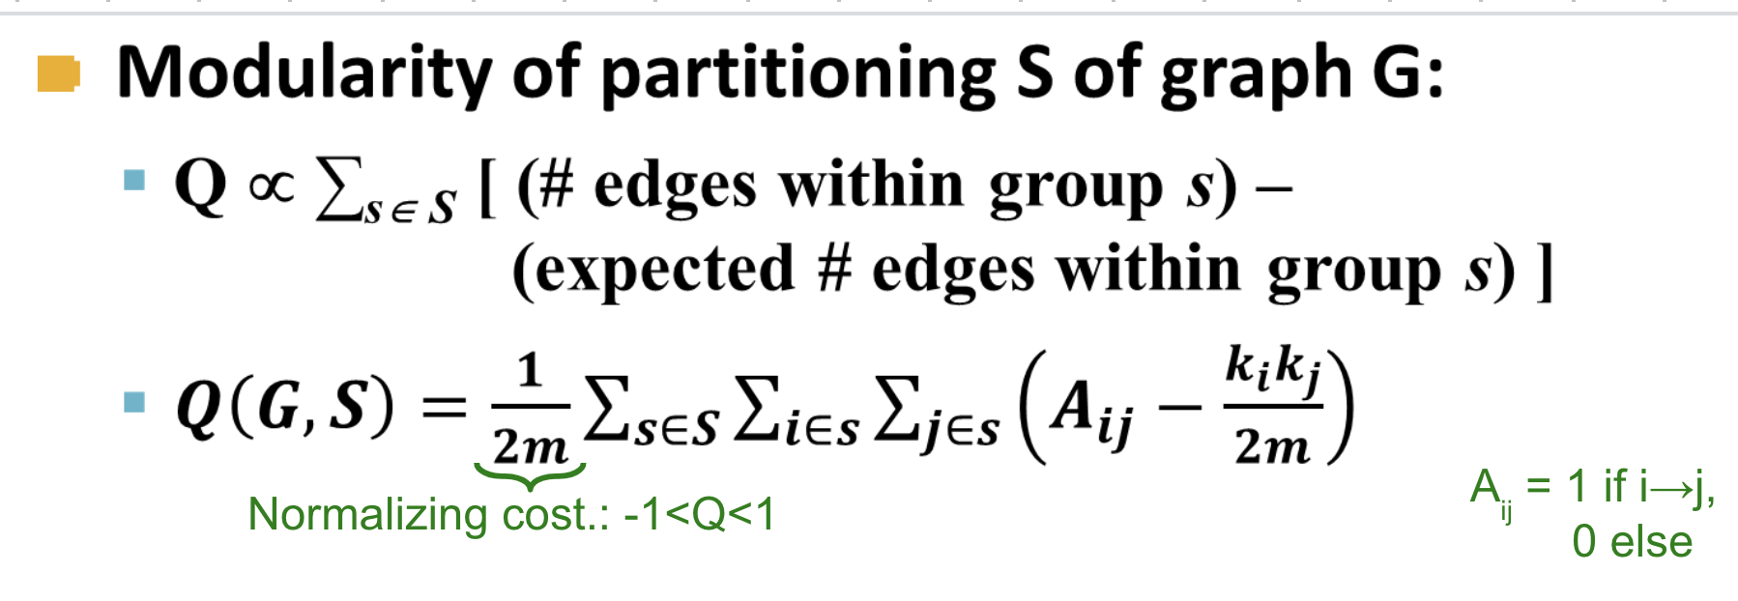
Modularity
The expected
existence of the edge in s
All possible pairs of node in s
The actual
existence of the edge in s
Modularity values takes range [-1,1]
It is positive if the number of edges within groups exceeds the expected number
Q > 0.3-0.7 means significant community structure
Notes:
Example 1: A—B—C
there are three possible cuts: {A, B–C}, {A–B,C}, or {A,B,C}
No matter how you cut, the Q values are 0.5, 0.5, -1.0.
Example 2.
A — B
\ /
C
Any fully connected graph G, Q(G)=+1.0, cut only reduces Q value
Example 3
A -- B ------------ D -- E
\ / (cut) \ /
C F
Before cutting, sum up all possible 15 edges, 7 exists, 8 not.
After cutting, calculate Q for each subgraph and then sum up.
Notice that for an "empty" subgraph with nodes but no edges, Q = -1.
For a "full" subgraph with all possible edges, its Q = +1.
In the above, both subgraphs are "full". For example, for {A,B,C}, the number of edges m=3 (or m=7), and the degree for every node is 2 (or use the degree before the cutting), hence
(1 - 2*2/2*3) + (1 - 2*2/2*3) + (1 - 2*2/2*3) = 1/3 + 1/3 + 1/3 = 1.
So the Q value for the two subgraphs is 1 + 1 = 2.

Slide 34
Modularity (details)
The expected
existence of the edge in s
All possible pairs of nodes in s: both (i,j),(j,i), but not (i,i),(j,j)
The actual
existence of the edge in s
Hints
Determine m and ki, kj based on G (before cuttings)
Determine Aij based on s in S (after cuttings)
If s={n_{x}} is a singleton, then use 2*(0 - kx*kx/2m) = -kx*kx/m

Slide 35
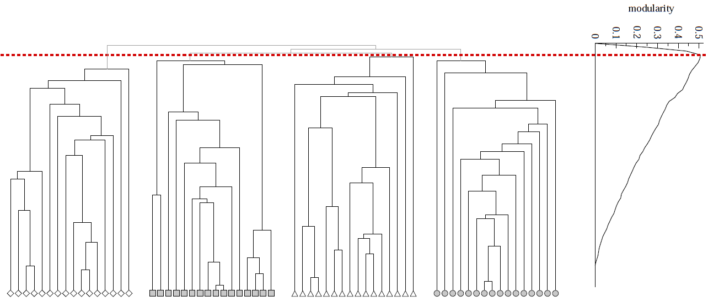
Modularity: Number of clusters
Modularity is useful for selecting the number of clusters:
Q

Slide 36
Exercises for Modularity
What is the modularity Q(G,S) of partition S of G:
1: G is partition into itself (no cutting) S={G}
2: G is partitioned into S of all single nodes
3: G is partitioned into two communities
S1 = {one single node x}
S2 = {G-x}
4: if G is below, S1={A-B-C-A}, S2={D-E-F-D}
A -- B ------------ D -- E
\ / \ /
C F

Slide 37
A Sample Solution for Exercise 1
Assume a graph G as follows: m=3, and the degree for node k(x) = k(y) = k(z) = 2.
x -- y
\ /
z
If S={G}, then the modularity of Q(G,S)=Q(G,{G}) can computed as:
For graph G, we have Axy=Ayx=1, Axz=Azx=1, Ayz=Azy=1, so
for node pair x-y: (1 – (2*2)/2m) = 2/6
for node pair y-x: (1 – (2*2)/2m) = 2/6
for node pair x-z: (1 – (2*2)/2m) = 2/6
for node pair z-x: (1 – (2*2)/2m) = 2/6
for node pair y-z: (1 – (2*2)/2m) = 2/6
for node pair z-y: (1 – (2*2)/2m) = 2/6
Q(G,S) = Q(G,{G}) = (1/2m)(2/6+2/6+2/6+2/6+2/6+2/6)=(1/6)*(2)=1/3.

Slide 38
A Sample Solution for Exercise 2
Assume a graph G as follows: m=3, and the degree for node k(x) = k(y) = k(z) = 2.
x -- y
\ /
z
If S={S1,S2,S3}, where S1={x}, S2={y}, S3={z} are all singleton sets with no edges, then
For S1, we have (0 – 2*(2*2)/2m) = 0 - 8/6 = -8/6
For S2, we have (0 – 2*(2*2)/2m) = 0 - 8/6 = -8/6
For S3, we have (0 – 2*(2*2)/2m) = 0 - 8/6 = -8/6
Q(G,S) = Q(G,{S1,S2,S3}) = (1/2m)(-(8/6)-(8/6)-(8/6)) = (1/6)*(-4) = -2/3.
Please solve Exercise 3 and 4 and post your solutions on Piazza.

Slide 39
Approaches
Clustering by edge ”betweenness”
Cut edges that have highest “betweenness”
Spectral Clustering
Minimizing the cut size by the 2nd Eigenvector
Direct Discovery
Thawing
Frequent itemsets

Slide 40
SPECTRAL CLUSTERING
Another approach to organizing social-network graphs
Notes:
2016spring w2-1

Slide 41
Partitioning Graphs
Another approach to organizing social networking graphs
Problem: partitioning a graph to minimize the number of edges that connect different components (communities)
Goal of minimizing the cut size
If you just joined Facebook with only one friend
Don’t want to partition the graph with you disconnected from rest of the world
Want components to be not too unequal in size

Slide 42
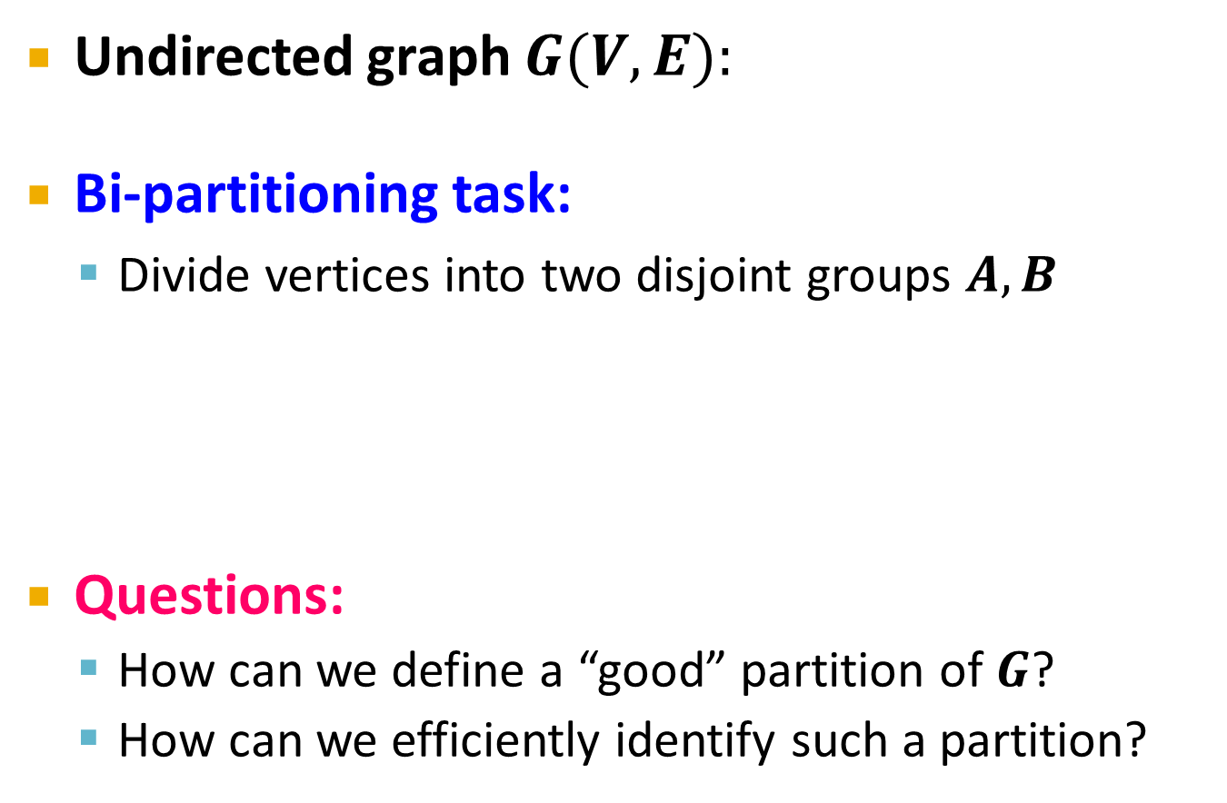
Graph Partitioning
1
5
2
6
4
3
A
5
B
1
2
6
3
4

Slide 43
Graph Partitioning
What makes a good partition?
Divide nodes into two sets so that the cut (set of edges that connect nodes in different sets) is minimized
Want the two sets to be approximately equal in size
Maximize the number of within-group connections
Minimize the number of between-group connections
5
1
2
6
4
3
A
B

Slide 44
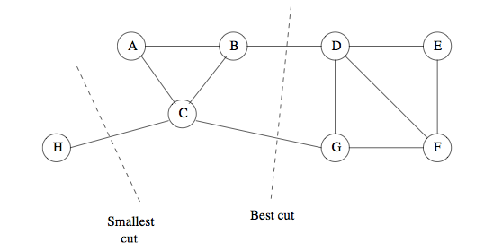
Example 10.14
If we minimize cut: best choice is to put H in one set, other nodes in other set
But: we reject partitions where one set is too small
Better is to use cut with (B,D) and (C,G)
Smallest cut is not necessarily the best cut

Slide 45
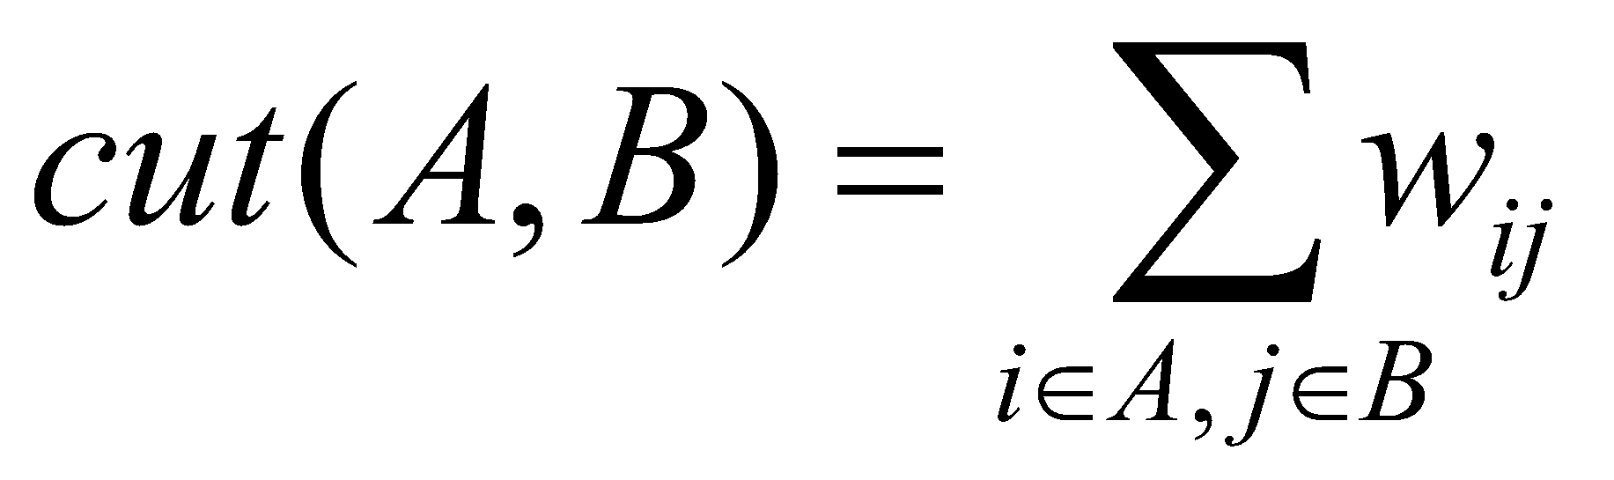
Graph Cuts
Express partitioning objectives as a function of the “edge cut” of the partition
Cut: Set of edges with only one vertex in a group:
A
B
5
1
cut(A,B) = 2
2
6
4
3

Slide 46
Graph Cut Criterion
Criterion: Minimum-cut
Minimize weight of connections between groups
Degenerate case:
Problem:
Only considers external cluster connections
Does not consider internal cluster connectivity
arg min_{A,B} cut(A,B)
“Optimal cut”
Minimum cut

Slide 47
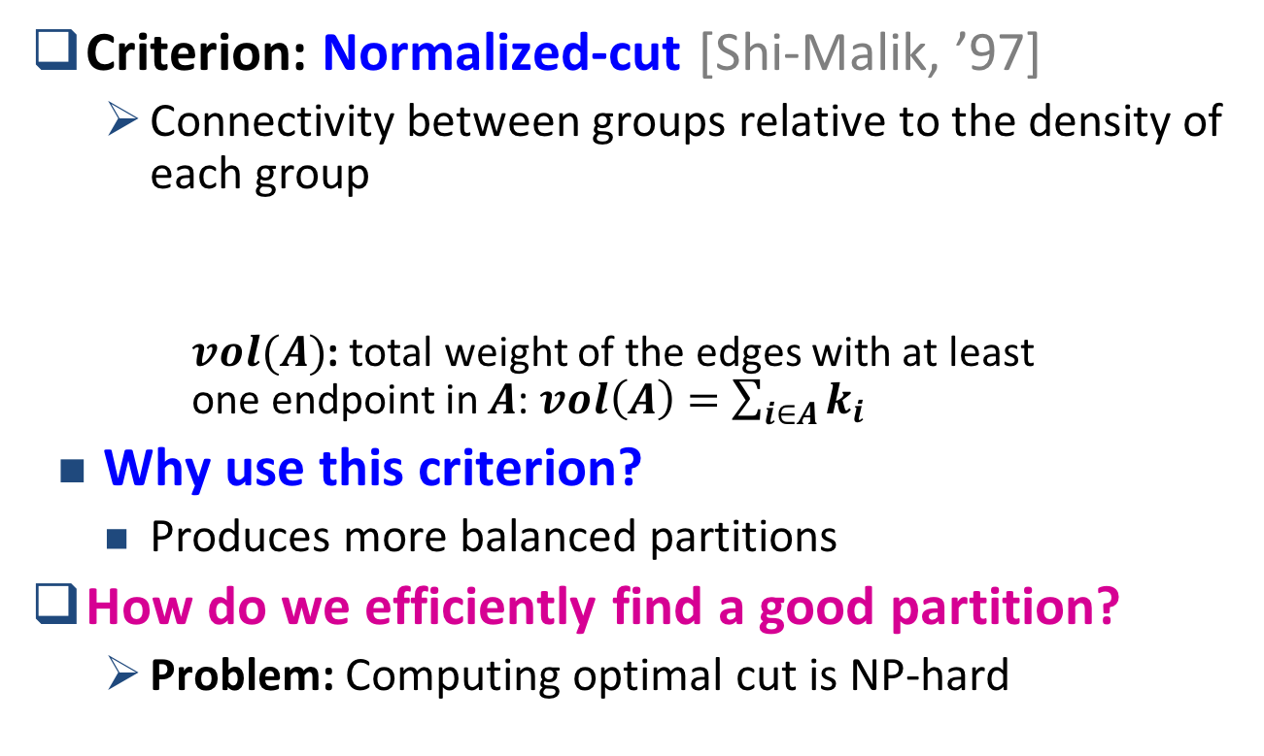
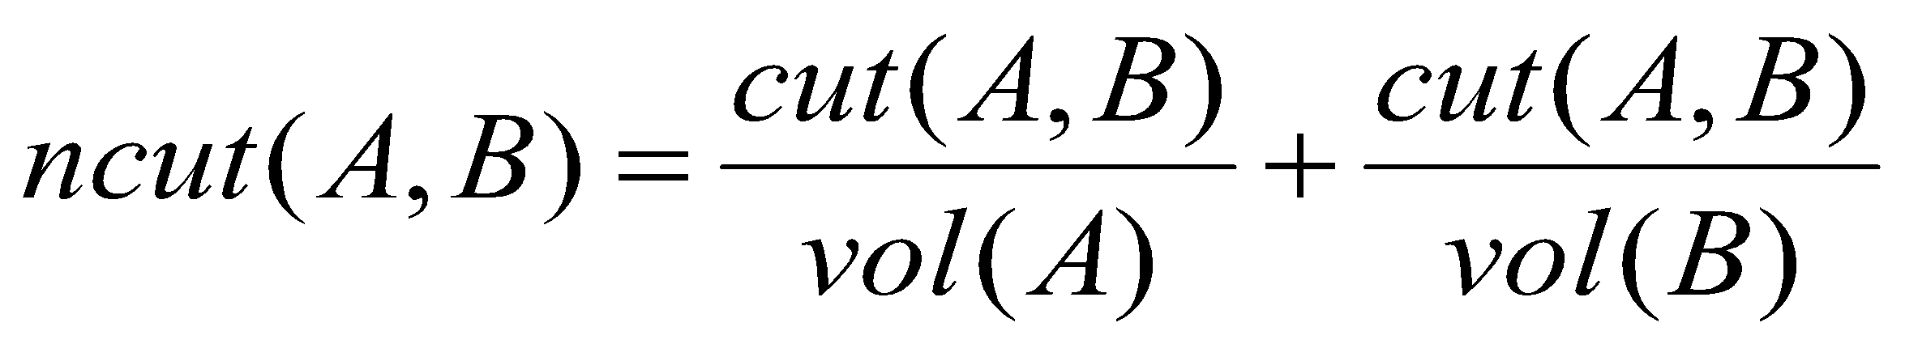
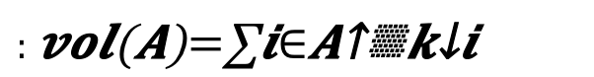
Graph Cut Criteria
[Shi-Malik]

Slide 48
Example 10.15
Partition nodes of graph into two disjoint sets S and T
Normalized Cut for S and T is:
Cut (S,T) + Cut(S,T)
Vol(S) Vol(T)
If we choose S={H} and T={A,B,C,D,E,F,G} then Cut(S,T) = 1
Vol(S) = 1 (number of edges with at least one end in S)
Vol(T) = 11: all edges have at least one node in T
Normalized cut is 1/1 + 1/11 = 1.09
For cut (B,D) and (C,G): S = {A,B,C,H}, T = {D,E,F,G}, Cut(S,T) = 2
Vol(S) = 6, Vol(T) = 7, normalized cut: 2/6 + 2/7 = 0.62

Slide 49
Using Matrix Algebra to Find Good Graph Partitions
Three matrices that describe aspects of a graph:
Adjacency Matrix
Degree Matrix
Laplacian Matrix: difference between degree and adjacency matrix
Then get a good idea of how to partition graph from eigenvalues and eigenvectors of its Laplacian matrix
Notes:
Given a linear transformation T, there is a “Eigen” vector v, such that apply T to v does not change the direction of v, but only the scale of v
T(v) = λv
Where λ is a scale factor.

Slide 50
Matrix Representations
Adjacency matrix (A):
n x n matrix
A=[a_{ij}], a_{ij}=1 if edge between node i and j
Important properties:
Symmetric matrix
Eigenvectors are real and orthogonal
dot_product(Eigenvectors_i, Eigenvectors_j) = 0
 | 1 | 2 | 3 | 4 | 5 | 6
1 | 0 | 1 | 1 | 0 | 1 | 0
2 | 1 | 0 | 1 | 0 | 0 | 0
3 | 1 | 1 | 0 | 1 | 0 | 0
4 | 0 | 0 | 1 | 0 | 1 | 1
5 | 1 | 0 | 0 | 1 | 0 | 1
6 | 0 | 0 | 0 | 1 | 1 | 0
5
1
2
6
4
3
Notes:
2016Spring w1-2

Slide 51
Matrix Representations
Degree matrix (D):
n x n diagonal matrix
D=[d_{ii}], d_{ii} = degree of node i
 | 1 | 2 | 3 | 4 | 5 | 6
1 | 3 | 0 | 0 | 0 | 0 | 0
2 | 0 | 2 | 0 | 0 | 0 | 0
3 | 0 | 0 | 3 | 0 | 0 | 0
4 | 0 | 0 | 0 | 3 | 0 | 0
5 | 0 | 0 | 0 | 0 | 3 | 0
6 | 0 | 0 | 0 | 0 | 0 | 2
5
1
2
6
4
3

Slide 52
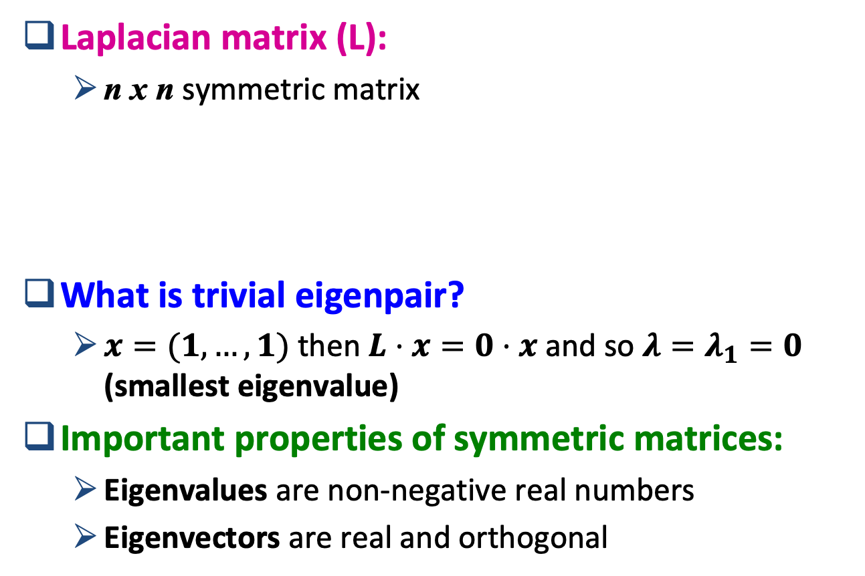

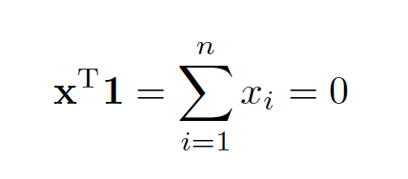
Matrix Representations (L=D-A)
 | 1 | 2 | 3 | 4 | 5 | 6
1 | 3 | -1 | -1 | 0 | -1 | 0
2 | -1 | 2 | -1 | 0 | 0 | 0
3 | -1 | -1 | 3 | -1 | 0 | 0
4 | 0 | 0 | -1 | 3 | -1 | -1
5 | -1 | 0 | 0 | -1 | 3 | -1
6 | 0 | 0 | 0 | -1 | -1 | 2
1
5
2
6
4
3
Why is L so interesting? Because Lx = 0 when x=I

Slide 53
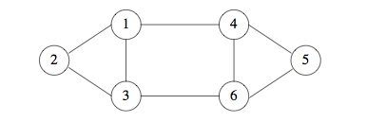
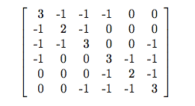
Example 10.19
L =
Graph and its Laplacian matrix
Why is L so interesting? Because Lx = 0 when x=I

Slide 54
EigenPair: EigenVector v, EigenValue λ
EigenVector
L =
L v = λ v
EigenValue
Graph and its Laplacian matrix
Why is L so interesting? because it has simple EigenPairs
that is, if v = I and λ = 0, then Lv = 0v

Slide 55
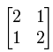
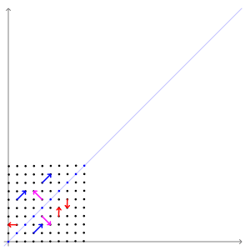
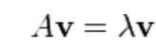
Eigenvalues and Eigenvectors
The transformation matrix A = preserves the direction of vectors parallel to v = (1,−1)^{T} (in purple) and w = (1,1)^{T} (in blue). The vectors in red are not parallel to either eigenvector, so, their directions are changed by the transformation.
http://setosa.io/ev/eigenvectors-and-eigenvalues/
https://en.wikipedia.org/wiki/Eigenvalues_and_eigenvectors
Notes:
2018 summer w1.1

Slide 56
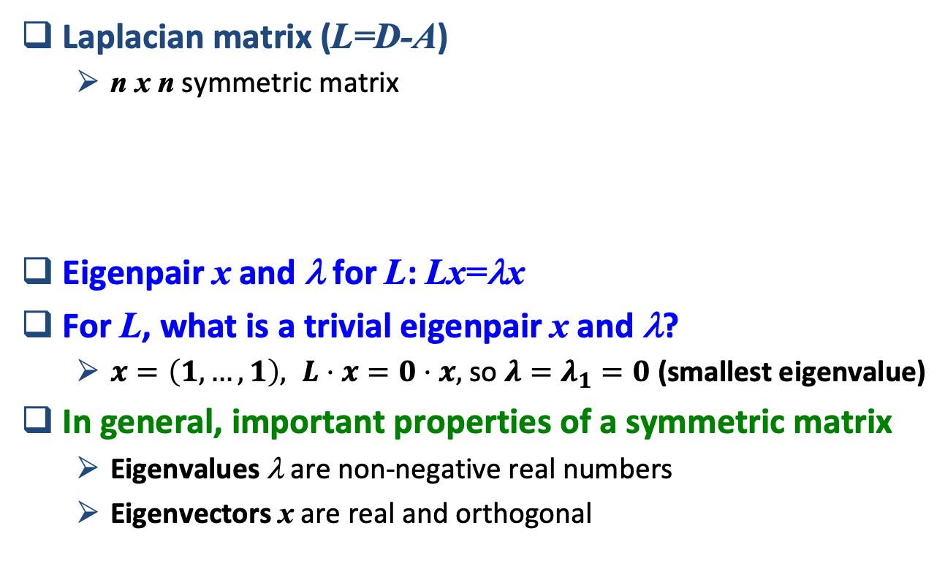
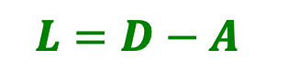
Examples of Eigenpairs for L
 | 1 | 2 | 3 | 4 | 5 | 6
1 | 3 | -1 | -1 | 0 | -1 | 0
2 | -1 | 2 | -1 | 0 | 0 | 0
3 | -1 | -1 | 3 | -1 | 0 | 0
4 | 0 | 0 | -1 | 3 | -1 | -1
5 | -1 | 0 | 0 | -1 | 3 | -1
6 | 0 | 0 | 0 | -1 | -1 | 2
1
5
2
6
4
3

Slide 57
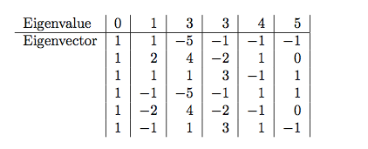
Example (cont.)
Eigenvector
Use standard math package to find all eigenvalues and eigenvectors
(Have not scaled eigenvectors to length 1, but could so easily)
Second eigenvector has three positive and three negative components
Suggest obvious partitioning of {1,2,3} and {4,5,6}

Slide 58
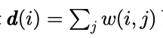
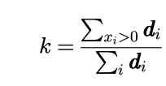
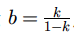
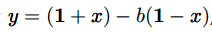

Ncut as an optimization problem
Let
x_{i} = -1 if i node is in A; otherwise x_{i} = 1
A
B
x =
(-1, -1, -1, 1, 1, 1)
Let degree
when in our case, w(i, j) = 1
Let
and
Let
Read
[Shi-Malik, ’97]

Slide 59

Ncut as an optimization problem
Rayleigh Quotient:
is minimized by the next smallest eigenvector of A
Graph Theory

Slide 60

λ₂ as optimization problem

Slide 61

λ₂ as optimization problem

Slide 62

Recall: Example
Use standard math package to find all eigenvalues and eigenvectors
(Have not scaled eigenvectors to length 1, but could)
Second eigenvector has three positive and three negative components
Suggest obvious partitioning of {1,2,3} and {4,5,6}

Slide 63
So far…
How to define a “good” partition of a graph?
Minimize a given graph cut criterion
How to efficiently identify such a partition?
Approximate using information provided by the eigenvalues and eigenvectors of a graph
Spectral Clustering
Naïve approach:
Split at 0

Slide 64
Spectral Clustering Algorithms
Three basic stages:
1) Pre-processing
Construct a matrix representation of the graph
2) Decomposition
Compute eigenvalues and eigenvectors of the matrix
Map each point to a lower-dimensional representation based on one or more eigenvectors
3) Grouping
Assign points to two or more clusters, based on the new representation

Slide 65
Spectral Partitioning Algorithm
1) Pre-processing:
Build Laplacian matrix L of the graph
2) Decomposition:
Find eigenvalues λ and eigenvectors x of the matrix L
Map vertices to corresponding components of λ₂
 | 1 | 2 | 3 | 4 | 5 | 6
1 | 3 | -1 | -1 | 0 | -1 | 0
2 | -1 | 2 | -1 | 0 | 0 | 0
3 | -1 | -1 | 3 | -1 | 0 | 0
4 | 0 | 0 | -1 | 3 | -1 | -1
5 | -1 | 0 | 0 | -1 | 3 | -1
6 | 0 | 0 | 0 | -1 | -1 | 2
0.0
0.4
0.3
-0.5
-0.2
-0.4
-0.5
1.0
0.4
0.6
0.4
-0.4
0.4
0.0
λ=
3.0
X =
0.4
0.3
0.1
0.6
-0.4
0.5
3.0
0.4
-0.3
0.1
0.6
0.4
-0.5
4.0
0.4
-0.3
-0.5
-0.2
0.4
0.5
5.0
0.4
-0.6
0.4
-0.4
-0.4
0.0
1
0.3
2
0.6
3
0.3
How do we now find the clusters?
4
-0.3
5
-0.3
6
-0.6

Slide 66
Spectral Partitioning
3) Grouping:
Sort components of reduced 1-dimensional vector
Identify clusters by splitting the sorted vector in two
How to choose a splitting point?
Naïve approaches:
Split at 0 or median value
More expensive approaches:
Attempt to minimize normalized cut in 1-dimension (sweep over ordering of nodes induced by the eigenvector)
Split at 0:
Cluster A: Positive points
Cluster B: Negative points
1
0.3
A
B
2
0.6
3
0.3
4
-0.3
1
0.3
4
-0.3
5
-0.3
2
0.6
5
-0.3
6
-0.6
3
0.3
6
-0.6

Slide 67


Example: Spectral Partitioning
Value of x₂
Rank in x₂

Slide 68


Example: Spectral Partitioning
Components of x₂
Value of x₂
Rank in x₂

Slide 69


Example: Spectral partitioning
Components of x₁
Components of x₃
Notes:
As a result, while each eigenvector tries to produce a minimum-sized cut, the fact that successive eigenvectors have to
satisfy more and more constraints generally causes the cuts they describe to be
progressively worse.

Slide 70
k-Way Spectral Clustering
How do we partition a graph into k clusters?
Two basic approaches:
Recursive bi-partitioning [Hagen et al., ’92]
Recursively apply bi-partitioning algorithm in a hierarchical divisive manner
Disadvantages: Inefficient, unstable
Cluster multiple eigenvectors [Shi-Malik, ’00]
Build a reduced space from multiple eigenvectors
Commonly used in recent papers
Multiple eigenvectors prevent instability due to information loss
A preferable approach…
Notes:
2018 w1.2

Slide 71
Approaches
Clustering by edge ”betweenness”
Cut edges that have highest “betweenness”
Spectral Clustering
Minimizing the cut size by the 2nd Eigenvector
Direct Discovery
Thawing
Frequent itemsets

Slide 72

DIRECT DISCOVERY OF COMMUNITIES: TRAWLING
With slide contributions from P. Desikan; http://www-users.cs.umn.edu/~desikan/
Notes:
20170327

Slide 73
Web community
Groups of individuals who share common interests, together with the web pages most popular among them
Web page collections with a shared topic

Slide 74
Types of Communities
Explicitly-defined
Communities that manifest themselves as newsgroups or as resource collections on directories such as Yahoo!
Implicitly-defined
Communities that result from nature of content-creation of the web

Slide 75
Terms and Definitions (1)
Directed Bipartite Graph: A graph whose nodes set can be partitioned into two sets F and C, and every directed edge in the graph is from a node u in F to a node v in C
…
…
…
F
C

Slide 76
Terms and Definitions (2)
A Complete Bipartite Graph: A bipartite graph that contains all possible edges between a vertex of F and a vertex of C
Core: A complete bipartite subgraph with at least i nodes from F and at least j nodes from C
In the web world, the i pages the contains the links are referred to as ‘fans’ and the j pages that are referenced as ‘centers’
…
…
…
F
C

Slide 77
Trawling
[Kumar et al. ‘99]
Searching for small communities in the Web graph
What is the signature of a community / discussion in a Web graph?
Use this to define “topics”:
What the same people on the left talk about on the right
…
…
…
Dense 2-layer graph
Intuition: Many people all talking about the same things

Slide 78
Searching for Small Communities
A more well-defined problem: Enumerate complete bipartite subgraphs K_{s,t}
Where K_{s,t} : s nodes on the “left” where each links to the same t other nodes on the “right”
|X| = s = 3
|Y| = t = 4
X
Y
K_{3,4}
Fully connected

Slide 79

Frequent Itemset Enumeration
[Agrawal-Srikant ‘99]

Slide 80
From Itemsets to Bipartite K_{s,t}
[Kumar et al. ‘99]
Frequent itemsets = complete bipartite graphs!
How?
View each node i as a set S_{i} of nodes i points to
K_{s,t} = a set Y of size t (all items) that occurs in s (a basket) sets S_{i}
Looking for K_{s,t} 🡪 set of frequency threshold to s and look at layer t – all frequent sets of size t
a
b
S_{i}={a,b,c,d}
i
c
d
a
j
b
i
c
k
d
X (basket)
Y (all items)
s … minimum support (|X|=s)
t … itemset size (|Y|=t)

Slide 81
From Itemsets to Bipartite K_{s,t}
[Kumar et al. ‘99]
View each node i as a set S_{i} of nodes i points to
Say we find a frequent itemset Y={a,b,c} of supp s So, there are s nodes that link or point to all of {a,b,c}:
a
b
i
c
a
a
d
b
a
S_{i}={a,b,c,d}
b
x
y
z
c
c
b
Find frequent itemsets:
s … minimum support
t … itemset size
c
We found K_{s,t}!
K_{s,t} = a set Y of size t that occurs in s sets S_{i}
a
x
b
y
c
z
Y
X

Slide 82
Example
a
b
Support threshold s=2
{b,d}: support 3
{e,f}: support 2
And we just found 2 bipartite subgraphs:
c
d
e
f
Itemsets:
a = {b,c,d}
b = {d}
c = {b,d,e,f}
d = {e,f}
e = {b,d}
f = {}
a
b
c
d
c
d
e
f
e

